Slide 1


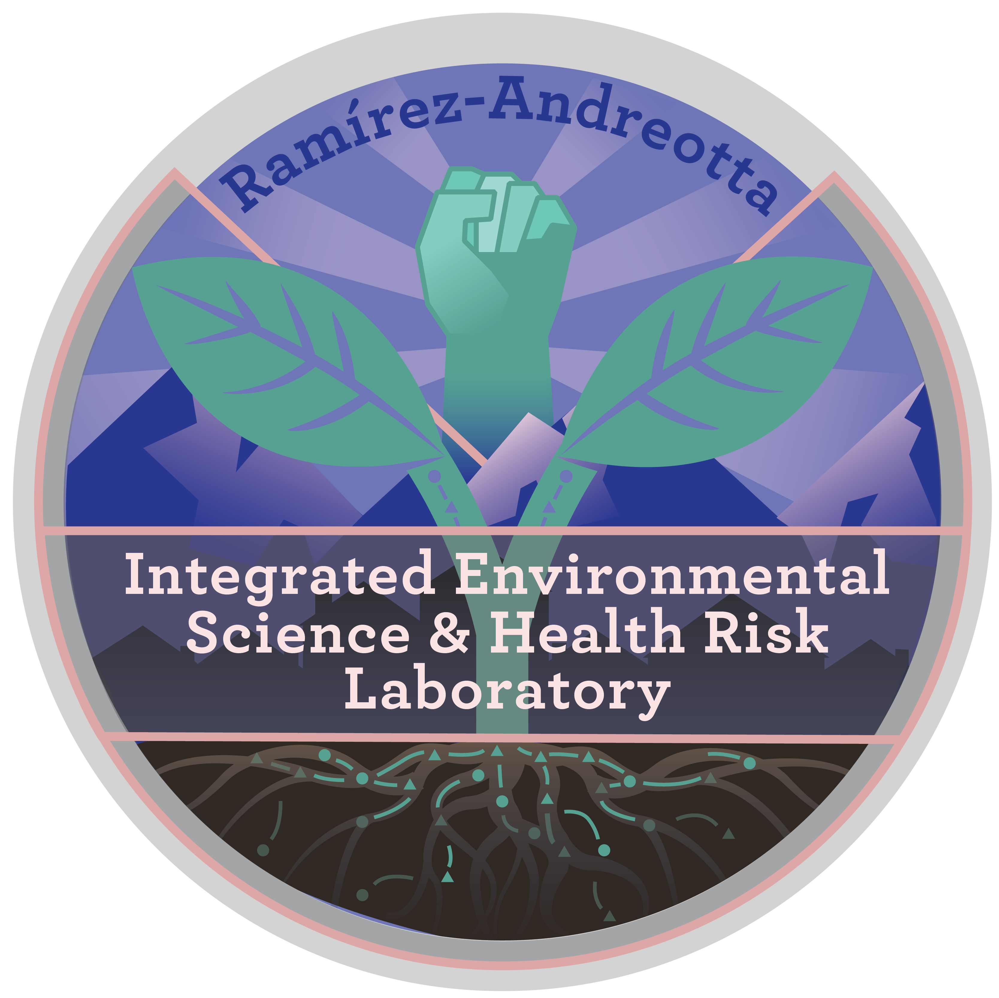


Lead Exposure in Arizona and Ohio: Visualizing Risk Through Environmental Health Mapping
Tayler John
Dr. Mónica Ramírez-Andreotta, Environmental Science, The University of Arizona
Arizona Space Grant Consortium Symposium, The University of Arizona

Slide 2


Why is this a problem?
Lead is still a critical public health issue, especially for:
Children under 5 (high absorption + long-term harm)
Low-income households (limited access to mitigation)
Older homes (pre-1980 = likely lead pipes/paint)
Despite progress, exposure risks persist and are not evenly distributed.

Slide 3
What We Set Out to Do
Develop a Lead Exposure Risk Index (LERI)
Apply LERI to:
Cuyahoga County, OH
Gila & Pinal Counties, AZ
Identify hotspots of vulnerability
Support public health interventions and work with community-based organizations

Slide 4
Building the Lead Exposure Risk Index (LERI)
Data source: 2023 5-year United States Census Bureau American Community Survey (ACS)
Indicators used:
Lead paint indicator
Children under the age of 5
Below the poverty line
Standardization: percentile normalization
LERI: Composite index (avg of normalized indicators)

Slide 5
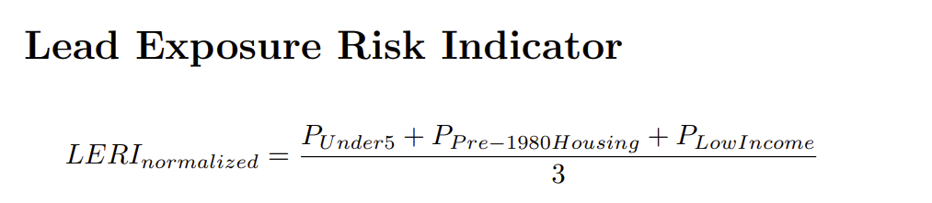
LERI

Slide 6
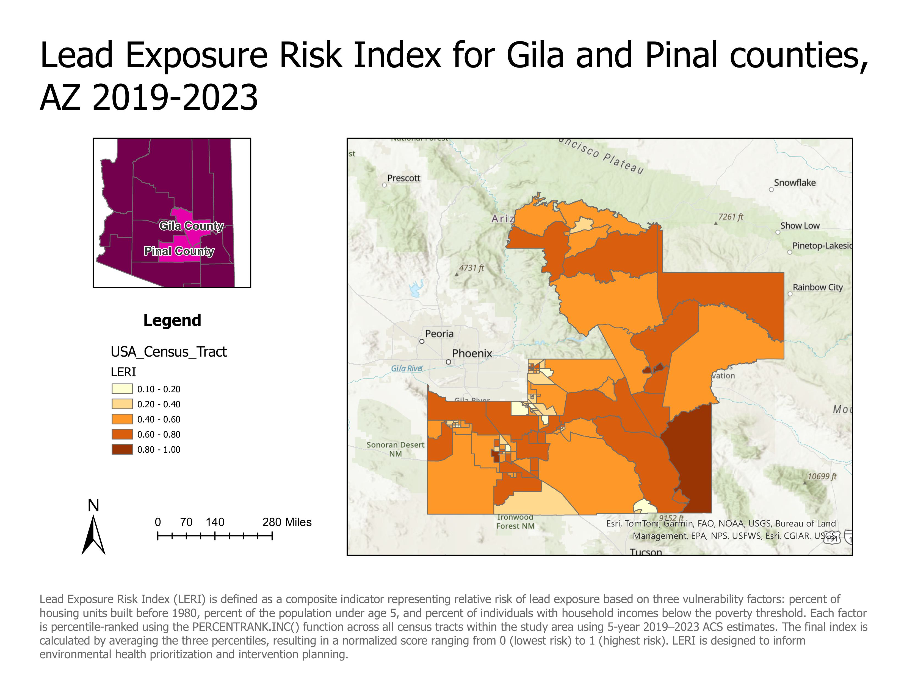
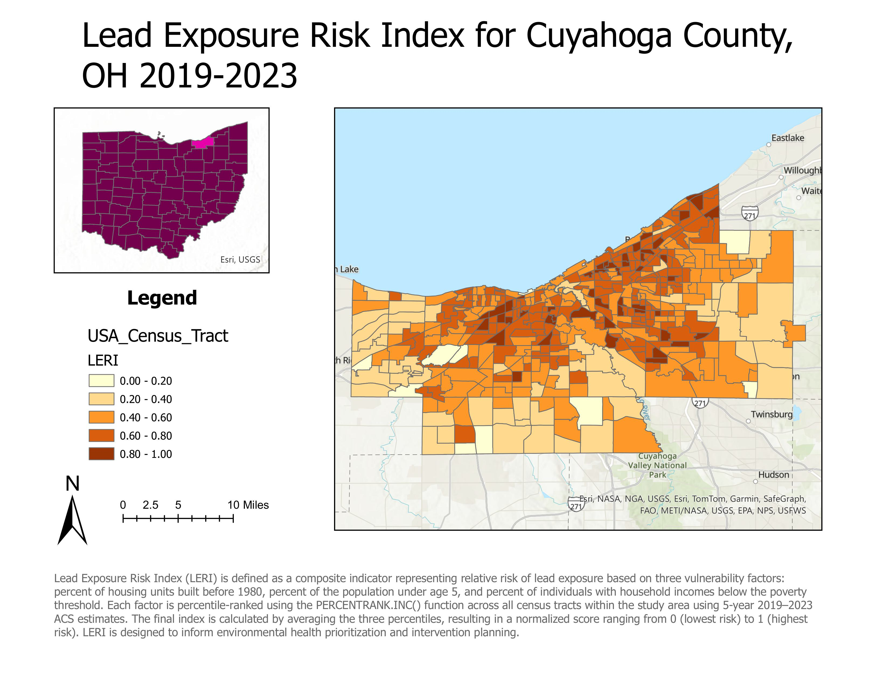
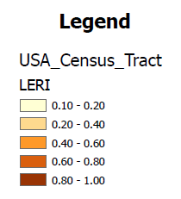
LERI for Arizona and Ohio

Slide 7
Where the Risk Lives
High-risk areas identified in:
Central Cleveland (Cuyahoga)
Parts of Globe/Miami (Gila)
Pinal rural zones near aging infrastructure

Slide 8
From Maps to Meaning
LERI is a replicable, scalable tool for:
Local, state and federal health departments
Housing policy
Resource allocation
Paves the way for:
Community-informed solutions
Lead abatement prioritization
Health equity planning

Slide 9
Acknowledgements
Cleveland Lead Advocates for Safe Housing (CLASH)
Regenerating Sonora
Ramirez-Andreotta Lab, The University of Arizona
Alma Anides Morales
William Borkan
National Institute of Health - National Institute of Environmental Health Sciences, grant number - 1R01ES036236

Slide 10
Thank You!

